Slide 1


Portable High Energy Experiment (PHEE) DAQ
Team Members: Ethan Barnes
John Sabra
Sang Hoon Chung
Sponsor: Michelle Chatter
Sandia National Laboratories
TA: Max Lesser

Slide 2

Executive Summary
Team # and name Team Mebers Sponsor
Problem statement:
The United States military possesses about 5500 nuclear weapons in its stockpile
The security of these weapons and equipment is paramount when they are transported for storage and testing
Sandia is interested in detecting explosive-type events in sensitive areas
Exact application for DAQ system may not be disclosed
The Portable High Energy DAQ System will:
Protect government equipment by detecting and identifying explosives within a 100 ft range
Utilizes microphone, accelerometer, and pressure sensor to classify if an explosive event occurred
Write output to removable storage device
User will be able to refer to past outputs

Slide 3
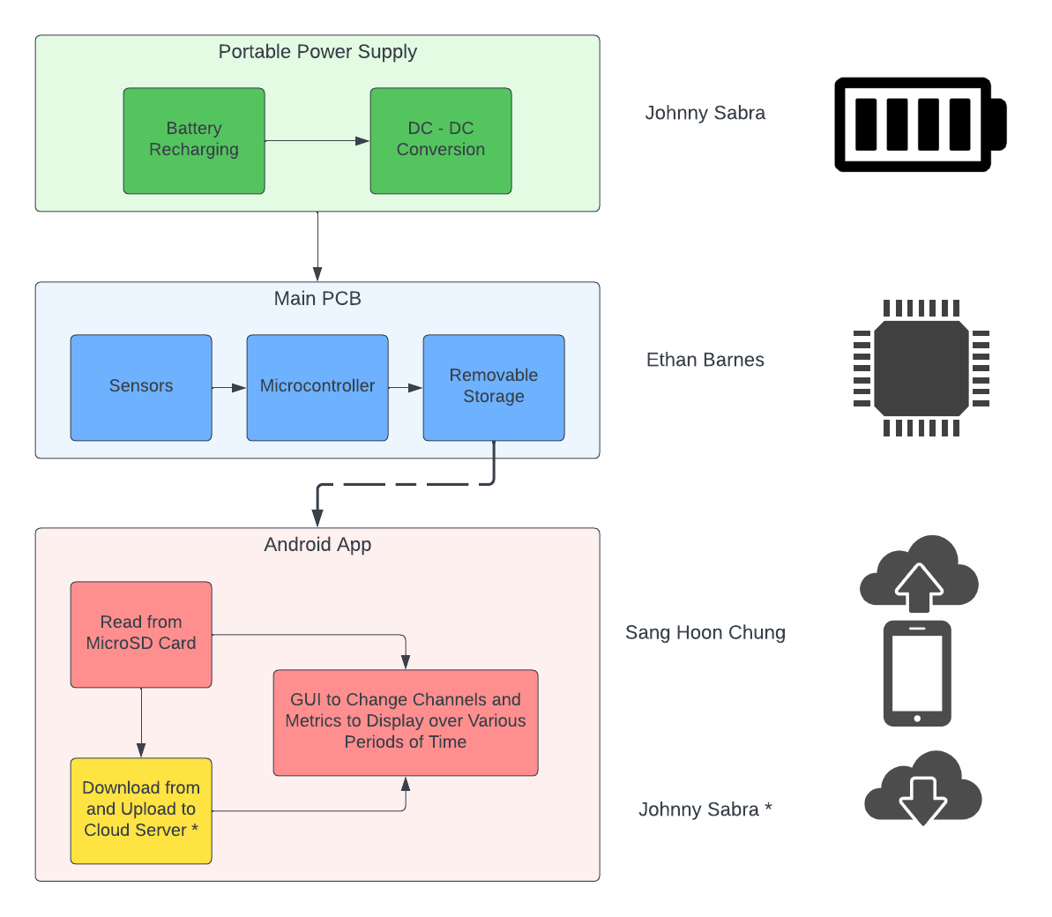
System Overview
Notes:
Cloud server and database

Slide 4
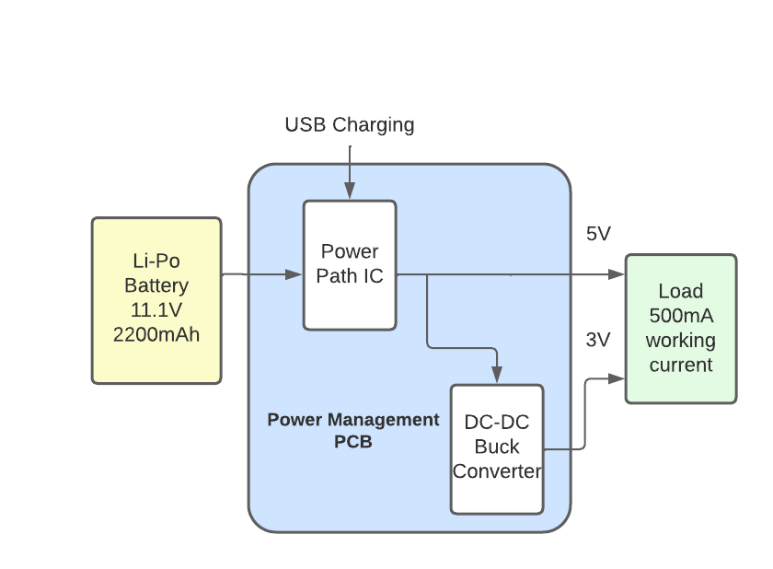
Power Supply Subsystem
Battery Pack:
Rechargeable at 1C rate
2200 mAh: lasts about 4.4 hours with estimated 500mA working current.
Lithium Polymer Chemistry
Less volatile than Li-ion considering working environment
Power Management:
Utilizes Battery Charger and DC-DC Buck converter IC
Buck converter uses 5V output
Supplies to voltages 5/3V.
SD card requires 3 V
Microcontroller 5 V

Slide 5
Power Supply Subsystem: Power Management ICs
Model Number | Input Range | Max Output Current | Price
TPS62A01 | 2.5 - 5.5 V | 1 A | $ 0.69
TPS62821 | 2.4 - 5.5 V | 1 A | $1.39
TPS566231 | 3 - 18 V | 6 A | $2.92
TPS568230 | 4.5 - 18 V | 8 A | $3.36
LM63615-Q1 | 3.5 - 36 V | 1.5 A | $3.37

Slide 6
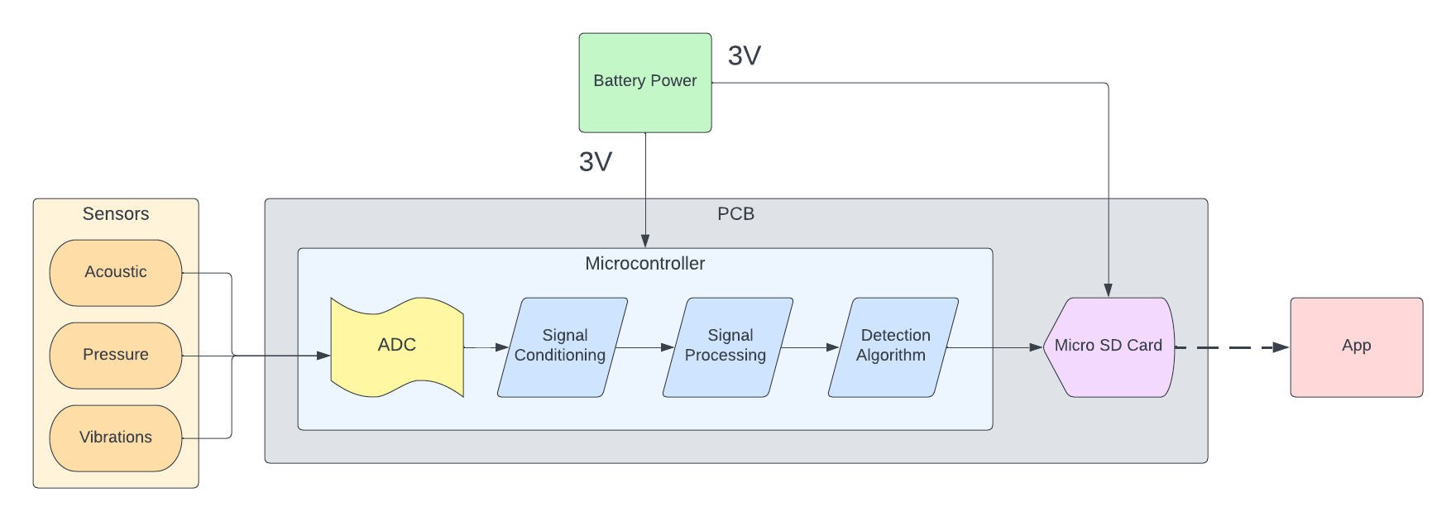
Microcontroller Subsystem
Sensor signals converted from analog to digital with ADC at 2 kHz
Signals are conditioned: reduce noise and amplify signal if needed
Detection algorithm determines in real time if an explosive event occurred
Sensor data and detection result are saved to a microSD card along with the date time information

Slide 7
Microcontroller Parts
 | STM32F446RET6 | ESP32-S3-WROOM-1-N8 | Arduino Uno
Clock Speed | 180 MHz | 240 MHz | 16 MHz
Flash Memory | 512 kB | 8 MB | 32 kB
SRAM | 128 KB | 512 kB | 2 kB
Pins | 64 | 45 | 28
ADC Resolution | 12 bit | 12 bit | 10 bit
ADC Sampling Rate | 7.2 MSPS | 100 kSPS | 9.6 kSPS
Wifi / Bluetooth | No | Yes | No
Bare MCU Price (Mouser) | $13.22 | $3.45 | N/A
Dev Board Price (Mouser) | $14.00 | $15.00 | $27.60

Slide 8

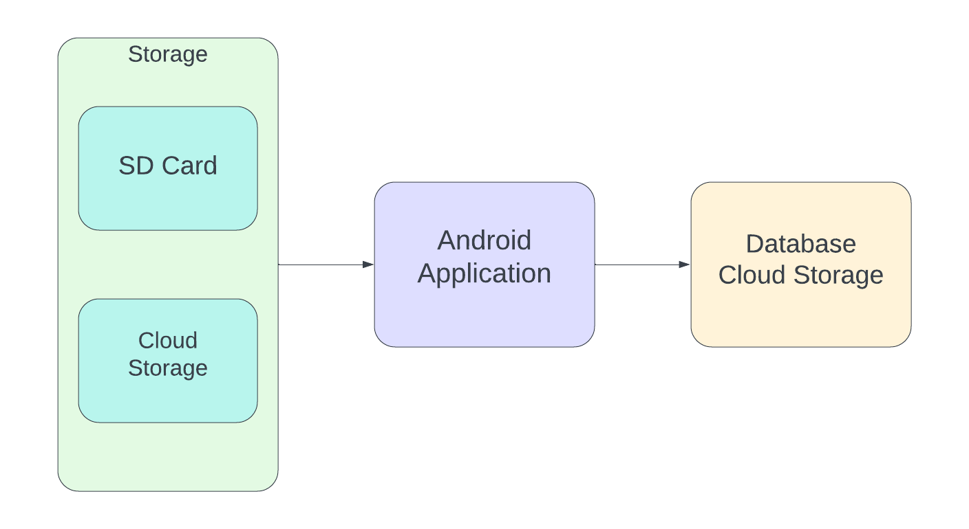
Android Application Subsystem
GUI should select different channels to display a small sample of the data (summary of data collected such as max, min, avg data points)
View signal data from either cloud server or microSD card

Slide 9
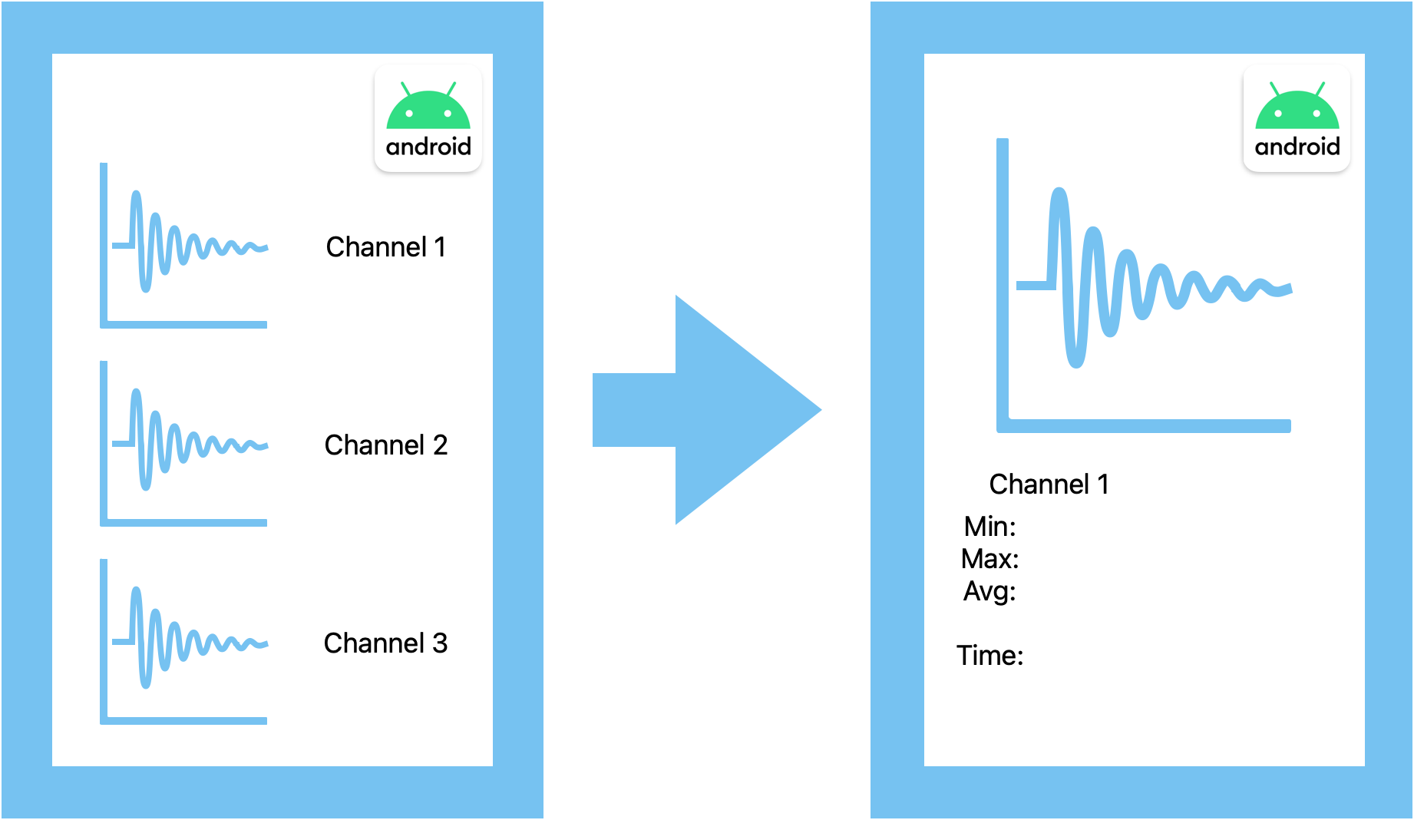
Android Application Subsystem
We can get specific information about the signal data when we click the channel
Stack the signal data to the Cloud server

Slide 10
Cloud Storage Database
Cloud database
Google Cloud Platform
SQL (Structured Query Language)
Relational database that works well with structured data
Enables user to upload raw sensor data to cloud database for data science applications
Date | Time | Explosion Detected | Decibels (dB) | Pressure (kPa) | Acceleration (G)
03/06/2023 | 12:35:46.789000 | 0 | 30.245 | 0.890 | 0.123
03/06/2023 | 12:35:46.789500 | 0 | 35.956 | 0.924 | 0.456
03/06/2023 | 12:35:46.790000 | 1 | 150.322 | 145.139 | 55.701

Slide 11
Execution and Validation
Currently: Outlined needs for each system
 | March 20th | March 27th | April 3rd | April 10 | April 17
Power Supply | 5 V output from Power Path IC | 3 V output from DC/DC Buck Converter | Buck Converter steps down the Power Path IC’s output | Power Path IC can take DC input via USB charging | Battery charges at 1C rate
Microcontroller | Sample at 2 kHz and get signal to noise ratio above 40 dB | Detection algorithm is 90% accurate | Write data to SD card in specified format | Functioning prototype using dev board | PCB design interfaces MCU with sensors and SD card port
Android Application | Develop GUI for users to interact with app | Read data from SD card and compute metrics on data | Set up the cloud server account and file directory | Connect from the cloud server to app | Upload and download the data to and from cloud server

Slide 12
Attributions
https://www.vecteezy.com/free-vector/battery-icon
https://www.vectorstock.com/royalty-free-vector/33-chip-icons-vector-36788616
https://www.vectorstock.com/royalty-free-vector/web-icons-set-vector-987846
https://www.vecteezy.com/free-vector/cloud-server-icon

